Slide 1

The European Accessibility Act So what for researchers and the research sector?
EAA Webinar
17 Sept. 2025

Slide 2
Welcome!
Captions running
We’ll audio describe onscreen content
Recording available after
Presentation available after
If there is anything we can do to make today’s session work better for you, please ask.
Notes:
Welcome
Thank you for coming to this exciting webinar
Grab a cup of tea/coffee open your notepad and open you mind as we have a great session ahead of us
Before we settle in let’s just check everyone is well set up to enjoy today’s content

Slide 3
A brilliant set of presenters for you!
Reginé Gilbert
Educator, designer, accessibility strategist and author. NYU Tandon School of Engineering. Paris EAA
Mark Walker
Head of Marketing AbilityNet. Host of EAA webinar series. Organiser of TechShare Pro conference
Trixie Cartwright
Global Head Strategic Initiatives Ipsos Ops. Inclusive research practices. Cross cultural inclusion leader
Christine Hemphill, FMRS - moderator
MRS Unlimited Co-Chair (soon research methods), Founder and MD of Open Inclusion
EDI Council Member MRS
Notes:
Reginé Gilbert
Regine Gilbert is a user experience designer, educator, and author. She the James Weldon Johnson Professor at New York University Tandon School of Engineering and has recently been based in Paris working on accessible tech, including understanding the implications of the EAA across a range of industries. She is also a consultant for large and small brands.
Regine is the author of Inclusive Design for a Digital World, Designing with Accessibility in Mind, published by Apress. She believes in making the world a more inclusive and accessible place. Her areas of research focus are digital accessibility, inclusive design and immersive experiences.
Trixie Cartwright
Trixie Cartwright is the Global Head of Strategic Initiatives at Ipsos Operations. One of the key focuses of this role is understanding how research can be more inclusive through the questions asked and the samples provided. She collaborates across countries to understand the cultural nuances, language and legal implications to help understand how to best address the needs of underserved communities.
She is an active member of the management team for Ipsos Operations and also works closely with industry bodies including the ESOMAR professional standards committee, and as a member of the Representation in Research steering group for the MRS.
Mark Walker
Mark Walker is Head of Marketing at UK Charity AbilityNet, a charity that supports organisations create accessible digital content and individuals access it.
Mark’s recent work includes hosting a series of webinars about the EAA which helped over 1,000 organisations understand the requirements of the Act and what they need to do about it. AbilityNet published a how to guide to help organisations meet the requirements of the EAA - available for download on the AbilityNet website.

Slide 4
MRS Unlimited
is a positive driving force for disability-inclusive research and researchers globally

Slide 5


Enabling greater talent and more accurate research
MRS Unlimited enable
Greater talent in the sector
Better, more complete and accurate research
Notes:
At MRS Unlimited we help ensure
Research teams and organisations are more inclusive of disabled talent
Market research is more accessible to and inclusive of disabled perspectives

Slide 6
Reginé Gilbert

Slide 7
POUR Principles
P Perceivable
O Operable
U Understandable
R Robust
Can I see/hear/access content?
Can I interact as required?
Do I understand content and interactions?
Does it work consistently across devices, assistive technology options and needs?

Slide 8
Mark Walker

Slide 9
Who is responsible for enforcement?

Slide 10
Legal action in France

Slide 11
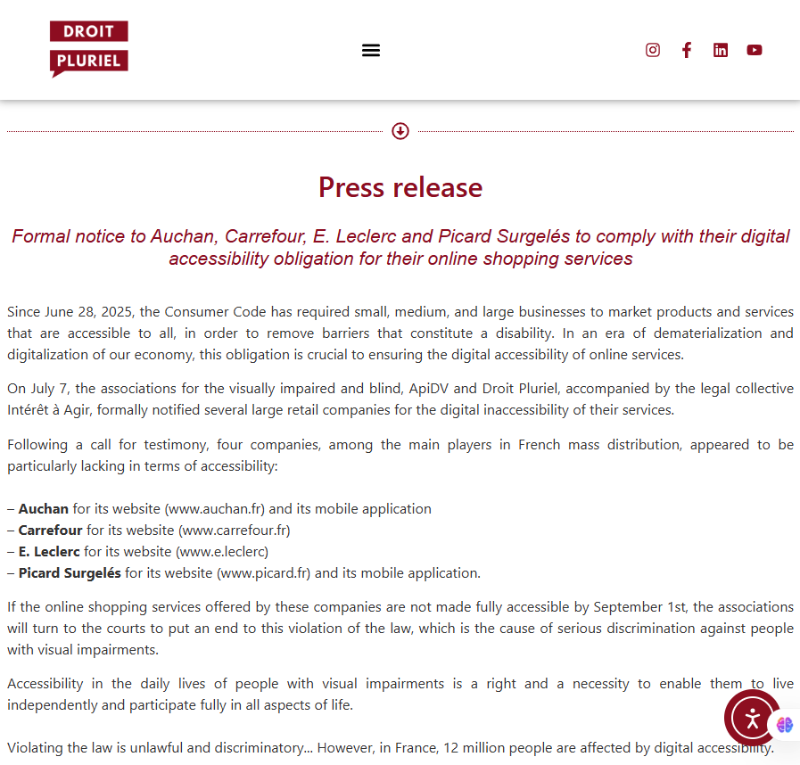
https://droitpluriel.fr/mise-en-demeure-des-entreprises-auchan-carrefour-e-leclerc-et-picard-surgeles-de-se-conformer-a-leur-obligation-daccessibilite-numerique-pour-leurs-services-de-courses-en-ligne/

Slide 12
Trixie Cartwright

Slide 13
16 million people
in the UK have a disability
Source: DWP Family Resources Survey
Notes:
16 million people in the UK have a disability, 24% of the population
This figure includes 11% of children, 23% of working-age adults, and 45% of pension-age adults.
These are huge numbers of the population (bigger than Gen x or Gen y) and as researchers we need to consider how we can ensure our research is as accessible and inclusive as it can be. Missing out parts of the population can distort and reduce the accuracy of the insights that we deliver

Slide 14

Understanding disability
Only around 8% of disabilities require the use of a wheelchair
Different aspects may include
Physical
Visual
Cognitive
Hearing
Psychiatric
Neurological
Notes:
When people think about disabilities, for many the first image that comes into their head is a wheelchair (I’m showing here the international symbol of access – the wheelchair symbol). People who use wheelchairs only represent a very small proportion of people with disabilities, around 8%.
A disability is a temporary or permanent condition that limits a major life activity and can be related to both general health and/or mental health.
There are many different aspects that can be considered a disability, different aspects listed here include physical, visual, cognitive, hearing, psychiatric and neurological.

Slide 15
Capturing data about disabilities is complex
Notes:
Capturing data about disabilities is complex
- The world health organization splits disability into 3 key areas, impairment, activity limitation and participation restrictions.
However, the UK government department for work and pensions has numerous disability groupings that break down into over 500 diagnosed disabilities – showing how complex it can be do research in this area

Slide 16
Experience of disability varies
Disabilities may or may not be:
Apparent
Diagnosed
Acknowledged
Accepted
Managed effectively
Notes:
Other considerations worth noting are that disabilities may be
apparent or not, it is not possible to tell whether many people have a disability, it’s estimated that around 80% of disabilities are not visible to others
diagnosed or not, some people may not consider they have a disability without a diagnosis, but may face similar challenges to those with a diagnosis, but not for example claim to have a disability when answering a question
acknowledged or not – some people may not really acknowledge that they have a disability, this is often true of the aging population, that just consider things get more difficult as they get older
accepted or not – in some cultures and countries disabilities and mental health conditions may not really be talked about, so it’s worth noting that there are different levels of acceptance and comfort in talking about or disclosing disabilities
managed effectively or not. Not all people with the same disability have the same experience, for example, consider a blind person with no aids, vs a blind person with a cane, vs a blind person with a guide dog, vs a blind person with access to screen reader supported technology etc.
- This is just some of what we need to consider as researchers and I hope highlights the complexity of the topic

Slide 17
EAA – impact on research agencies
Client
Our clients will need to ensure their digital services are accessible
New products and services must be accessible
Insights
More demand to understand the needs of people with disabilities
People with disabilities make great research participants
We need to create research with people with disabilities
Accuracy of Insights
Ensuring research is more inclusive
Increasing the accessibility of research surveys
Providing a voice for all
Better research
Notes:
So how does the EAA impact research agencies.
Firstly, it impacts our clients
All clients that provide services in the EU will need to ensure that any new digital products or services they launch are accessible and meet the EAA requirements
Their existing services will also need to become accessible over the coming years if they are not already
Inclusion in insights has been a topic for many years, however it feels like there is more momentum than ever before to ensure that the insights of people with disabilties are included. We certainly see more demand for research with people with disabilities, whether to ensure that they are in included in general research studies aimed at the total population or more targeted research working with communities of people with specific disabilities.
People with disabilities make great research participants as they often need to be creative to navigate the world, they can help provide even richer insights to our research – we should be working with people with disabilities when creating our research
Being inclusive is key, not only is it coming under legislation, ensuring our services are inclusive is the right thing to do, it’s good for your brand, or your client’s brands and it’s what many people, especially the young would expect from an employer they would like to work for.
it is not a tick box exercise where you just ask whether someone has a disability, as we’ve seen, not everyone will identify with having a disability, so it’s important to consider what question you ask, for example do you want to know if someone has a disability or do you want to understand if they find it challenging to interact with something, perhaps product packaging?
Asking the right questions and increasing accessibility of our research helps provide a voice for all
If we think about these things and accommodate needs the best we can, we will learn more, increasingly improve the accessibility of the research we do and ultimately end up with better research and more accurate insights.

Slide 18
Almost everyone will temporarily or permanently experience disability at some point in their life
Source: World Health Organization
Notes:
Disability is likely to touch most of us during our lifetime, either personally, or to a close friend or family member, so accommodating for disabilities is likely to benefit all of us at some point. Almost everyone will temporarily or permanently experience disability at some point in their life.

Slide 19
Over to you…
?
…

Slide 20
The MRS has created EAA guidance for the sector
https://www.mrs.org.uk/standards/mrs-best-practice-guide-on-accessible-data

Slide 21
Get involved in MRS Unlimited
If you are interested in joining us and helping progress disability-inclusion across the research sector please,
Visit our microsite (part of the MRS website) https://www.mrs.org.uk/about/mrs-unlimited
Join the mailing list to keep informed on upcoming events
Meet us at one of the MRS Conference events
Invite us to speak at your workplace (for a small fee)
Notes:
Join the mailing list to keep informed on upcoming events
Visit our microsite (part of the MRS website)
Meet us at one of the MRS Conference events (ask us who may be there)
Invite us to speak at your workplace (for a small fee)

Slide 22
Thank You!

